Slide 1


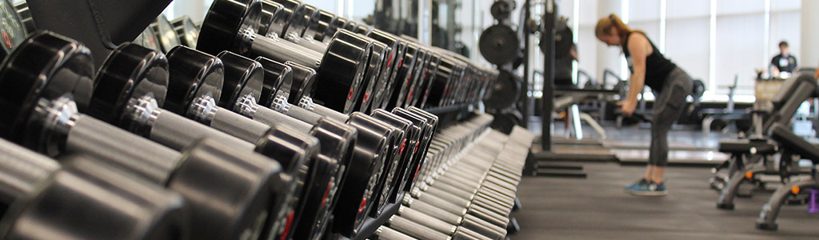
Health City Job Reference

Slide 2
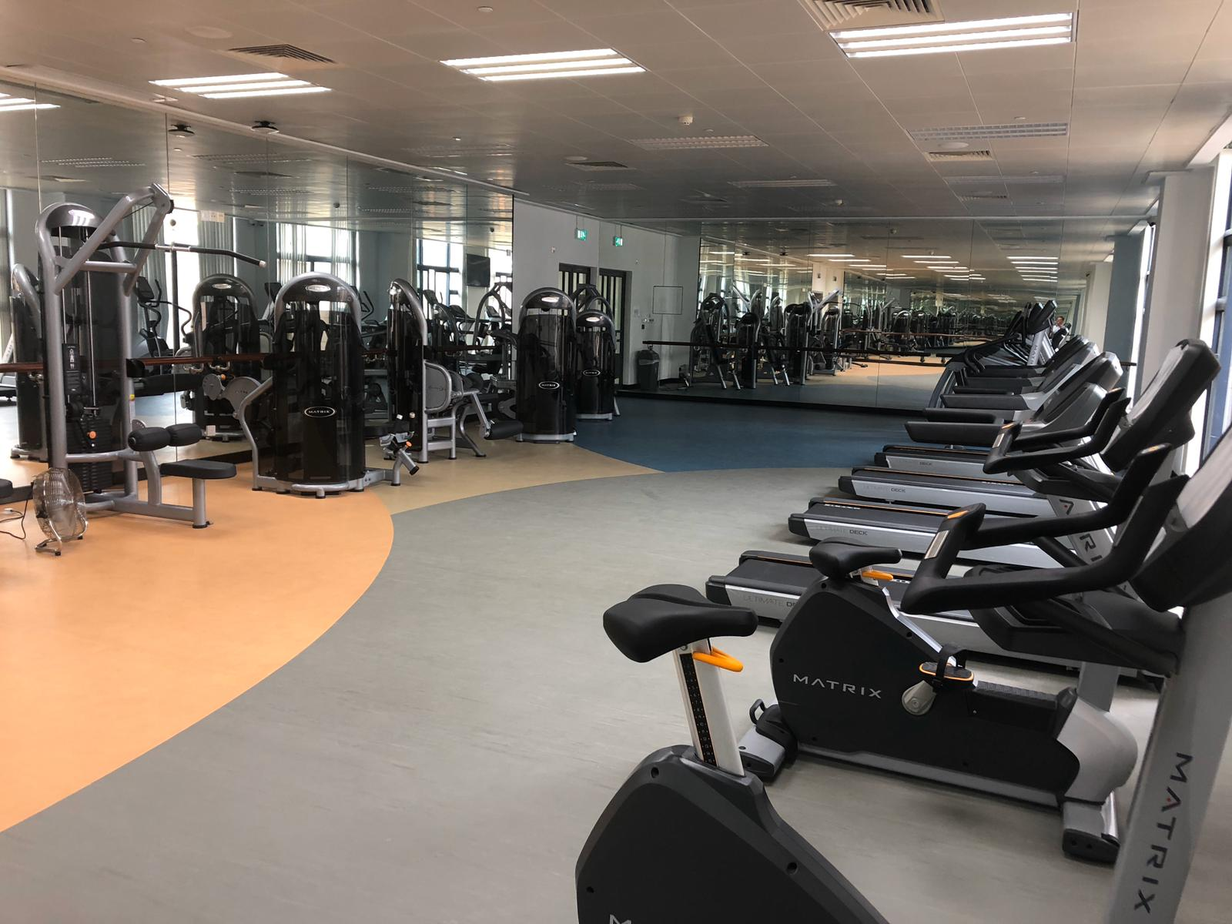
Job Reference for School / College/ University
N8 Sport Complex, University Of Macau
Stanley Ho East Asia College, University of Macau
Stanley Ho East Asia College, University of Macau
University of Macau Guest House (N1)
Macao Institute for Tourism Studies
Macau Polytechnic Institute
澳門大學綜合體育館N8
澳門大學何鴻燊東亞書院
澳門大學呂志和書院
澳門大學聚賢樓（N1）
澳門旅遊學院
澳門理工大學

Slide 3
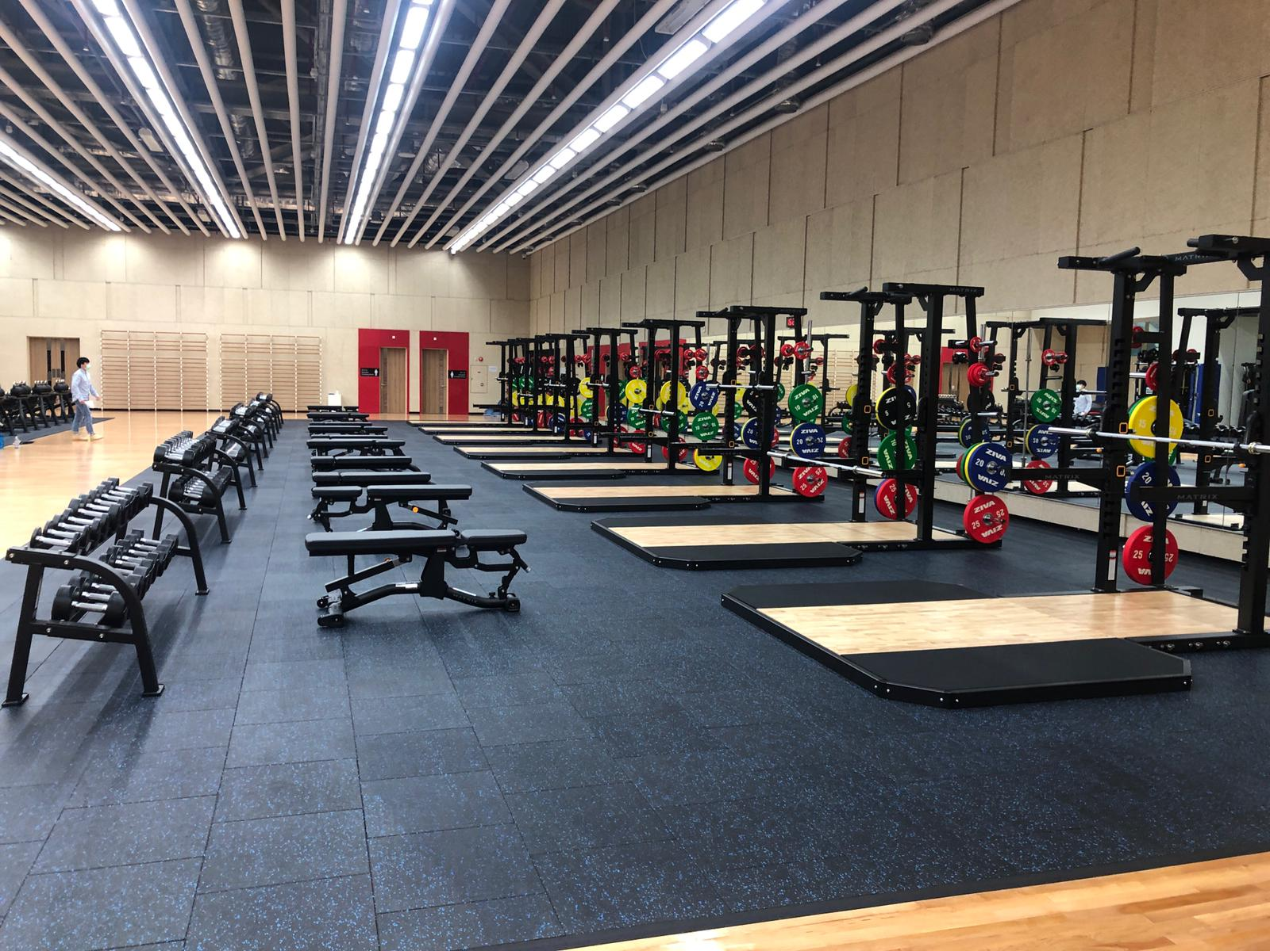
Job reference for Government/ Welfare Association
澳門紅十字會
澳門退休人士協會
澳門治安警察局
澳門氹仔運動員培訓及集訓中心
澳門體育局
澳門特別行政區行政長官辦公室
鮑思高青年服務網絡家庭健康促進中心
Cruz Vermelha de Macau
Associação dos Aposentados, Reformados e Pensionistas de Macau
Corpo de Policia de Seguranca Publica
Centro de Formação e Estágio de Atletas
Instituto do Desporto do Governo da RAEM
Office of the Chief Executive of the Macau Special Administrative Region
Macao Bosco Youth Service Network

Slide 4
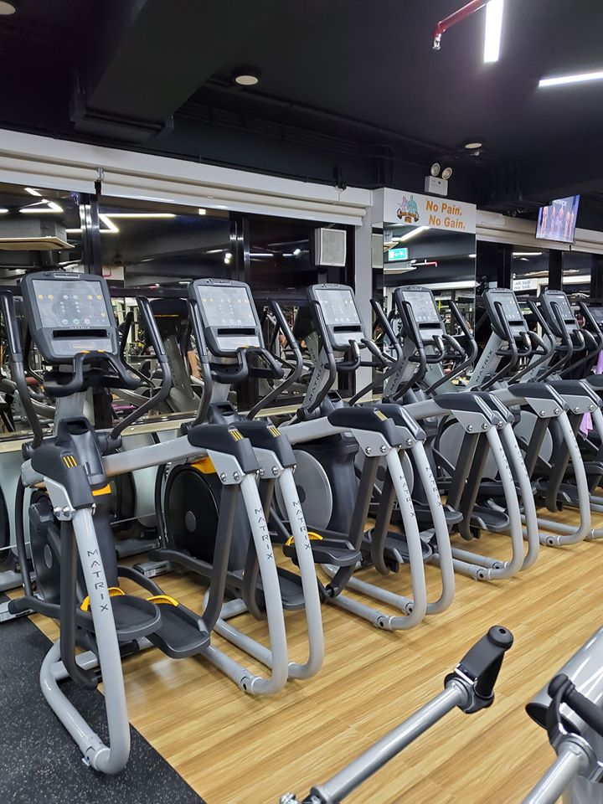
Job Reference for Commercial Fitness Centre
澳門力美健健身中心
澳門 Sky Fitness
澳門 Level Up Fitness
Macao Lamix Fitness
Macao Sky Fitness
Macao Level Up Fitness
Job Reference for Residential Clubhouse and Hotel
澳門利澳酒店
澳門凱泉灣
澳門泉健豪庭
RIO Hotel Macao
Riviera Macao
Macao Chun Kin Palace

